Slide 1
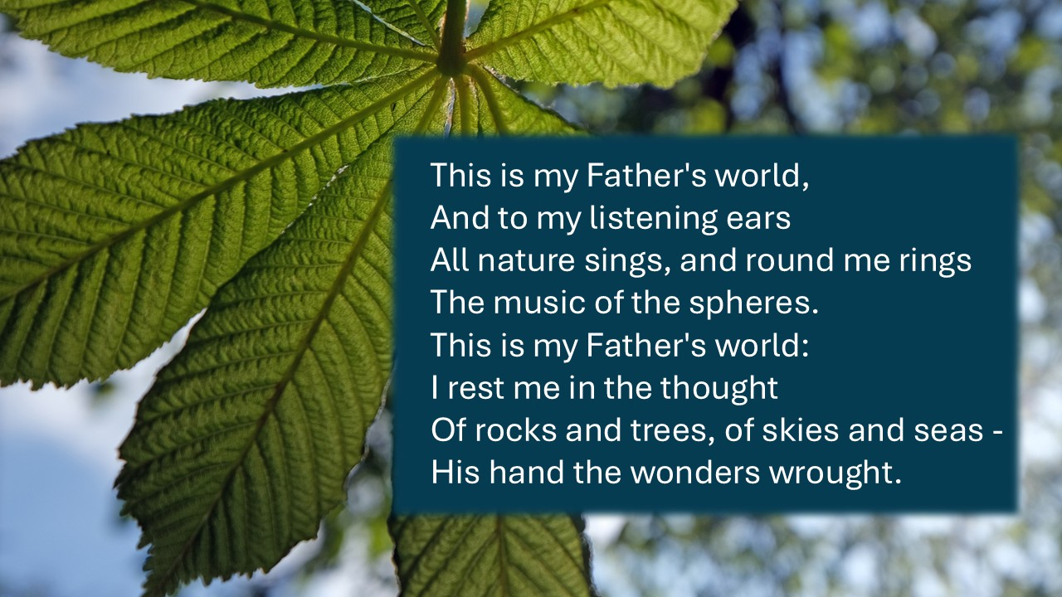
  This is my Father's world,
  And to my listening ears
  All nature sings, and round me rings
  The music of the spheres.
  This is my Father's world:
  I rest me in the thought
  Of rocks and trees, of skies and seas -
  His hand the wonders wrought.

Slide 2
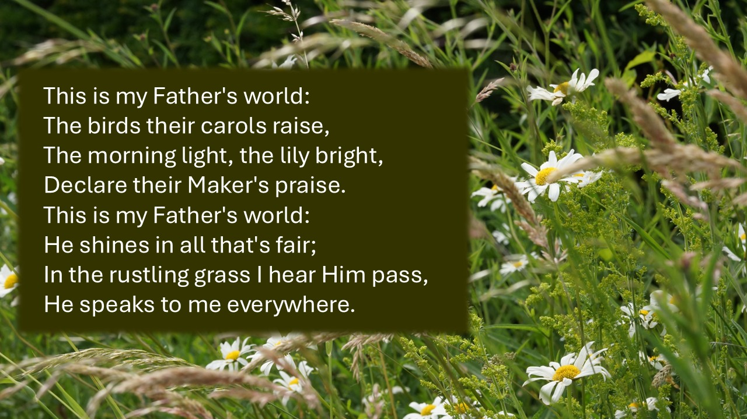

Slide 3
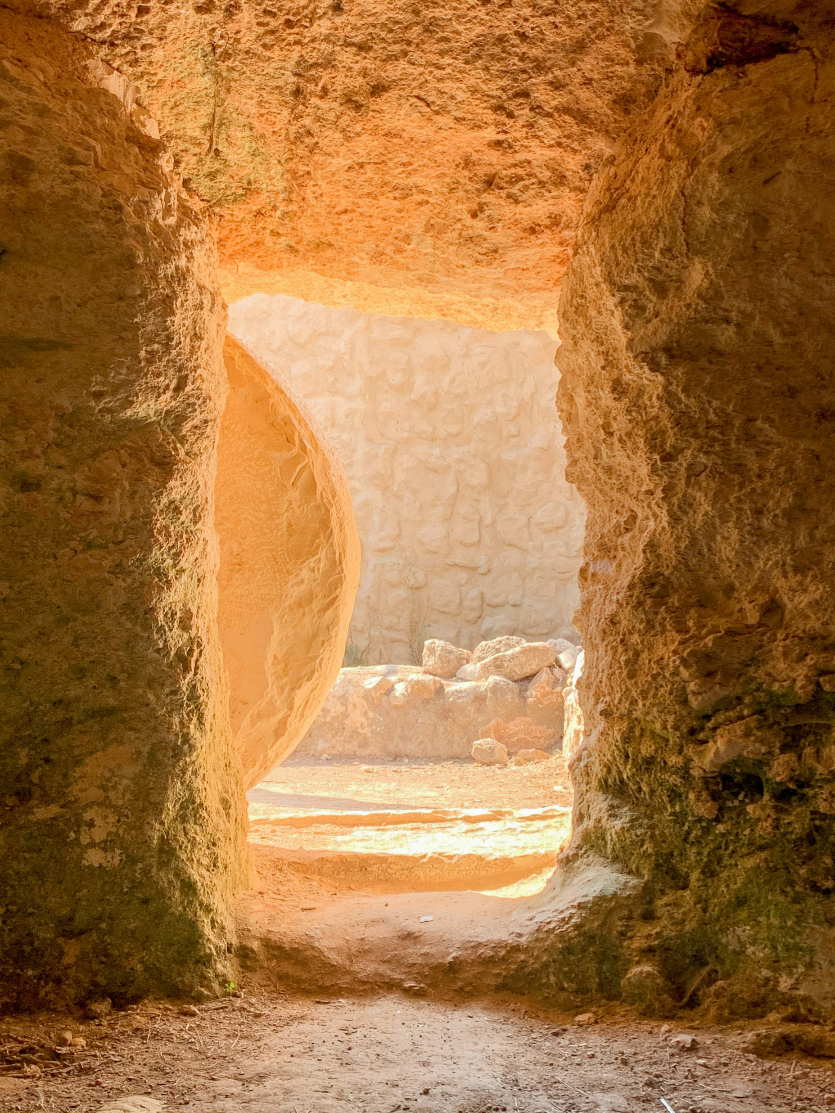
This is my Father's world:
O let me ne'er forget
That though the wrong seems oft so strong,
God is the Ruler yet.
This is my Father's world:
Why should my heart be sad?
The Lord is King: let the heavens ring!
God reigns; let earth be glad!
Words by Maltbie D Babcock, alt
Music traditional, arranged by Franklin L. Sheppard
Photo by Pisit Heng on Unsplash

