Slide 1
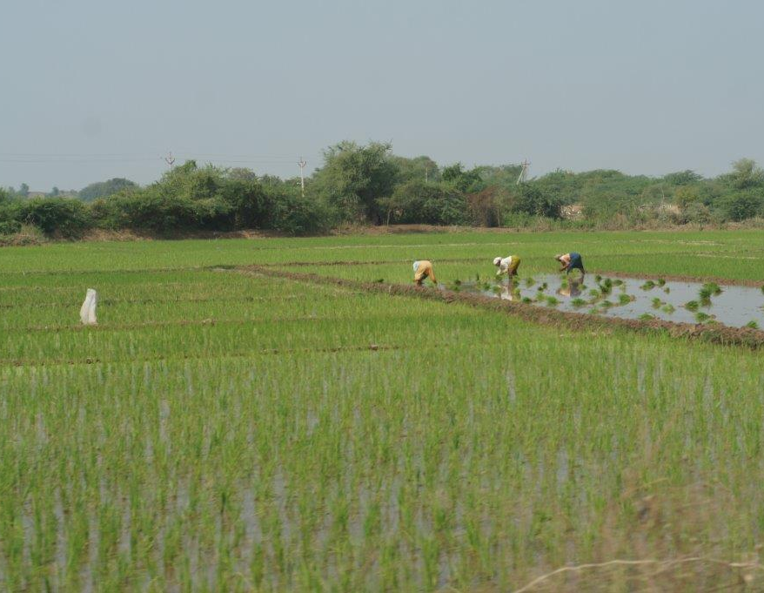
We pray, Lord, for India …
Have mercy on all its people.
Give its leaders wisdom, compassion, and a willingness to be guided in paths of righteousness and justice.
May all who seek to prevent and alleviate suffering know your blessing.
May all who are anxious or grieving know your comfort and protection.
Help your church throughout the land to be a witness to your love.
We ask these things in the name of our Saviour, Jesus Christ. Amen.

