Slide 1
A Time of Prayer for Refugees Globally

Slide 2
A reading from Scripture
Luke 10: 25-37

Slide 3
Luke 10: 25-37
And behold, a lawyer stood up to put him to the test, saying, “Teacher, what shall I do to inherit eternal life?”
He said to him, “What is written in the Law? How do you read it?”
And he answered, “You shall love the Lord your God with all your heart and with all your soul and with all your strength and with all your mind, and your neighbor as yourself.”
And he said to him, “You have answered correctly; do this, and you will live.”
But he, desiring to justify himself, said to Jesus, “And who is my neighbor?”

Slide 4
Luke 10: 25-37
Jesus replied, “A man was going down from Jerusalem to Jericho, and he fell among robbers, who stripped him and beat him and departed, leaving him half dead. Now by chance a priest was going down that road, and when he saw him he passed by on the other side. So likewise a Levite, when he came to the place and saw him, passed by on the other side. But a Samaritan, as he journeyed, came to where he was, and when he saw him, he had compassion. He went to him and bound up his wounds, pouring on oil and wine. Then he set him on his own animal and brought him to an inn and took care of him. And the next day he took out two denarii and gave them to the innkeeper, saying, ‘Take care of him, and whatever more you spend, I will repay you when I come back.’
Which of these three, do you think, proved to be a neighbor to the man who fell among the robbers?” He said, “The one who showed him mercy.” And Jesus said to him, “You go, and do likewise.”
ESV® Bible (The Holy Bible, English Standard Version®), copyright © 2001 by Crossway Bibles, a publishing ministry of Good News Publishers. Used by permission. All rights reserved.

Slide 5
We pray …
at a time of immense displacement,
in which millions of people have been forced from their homes
79.5 million people have been displaced
26 million people are refugees
UNHCR: Global Trends in Forced Displacement, 2019

Slide 6
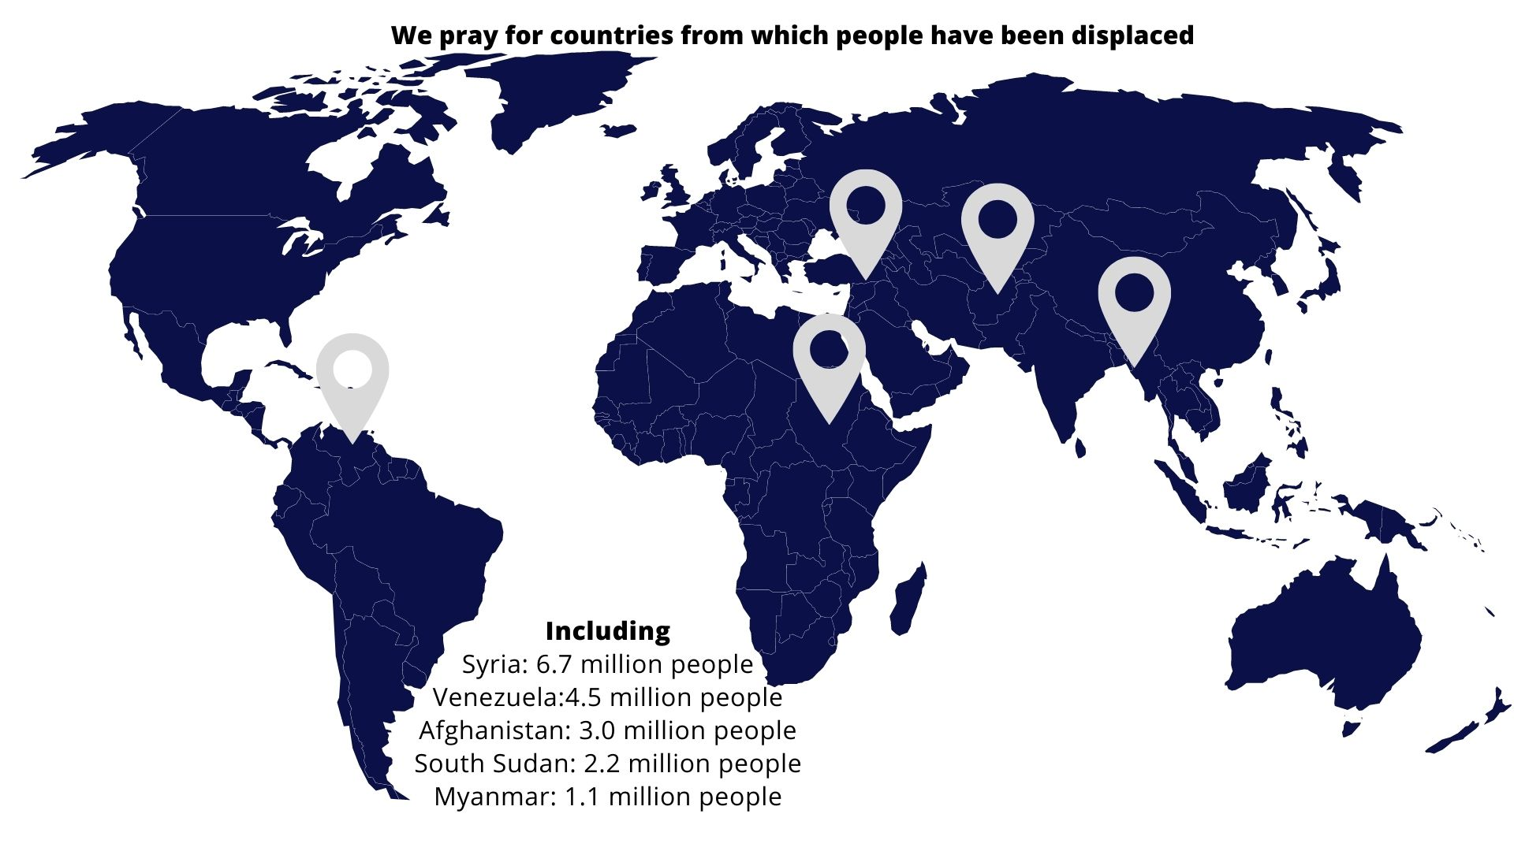
Data: UNHCR: Global Trends in Forced Displacement, 2019

Slide 7
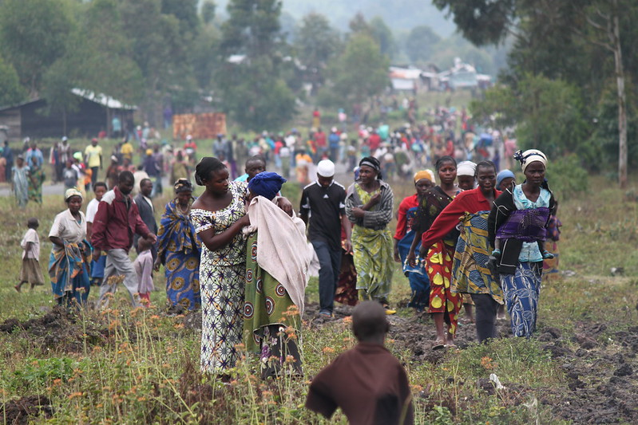
And all countries
affected by conflict …
Photo: Marie Cacace/Oxfam, sourced from Flickr under Creative Commons License

Slide 8
Please pray for the countries in which people are being displaced… and all who are being displaced

Slide 9
We pray for people who face perilous journeys …
… in the Mediterranean
… in the camps on the Greek Islands
… in Libya
… in Northern France and the Channel

Slide 10
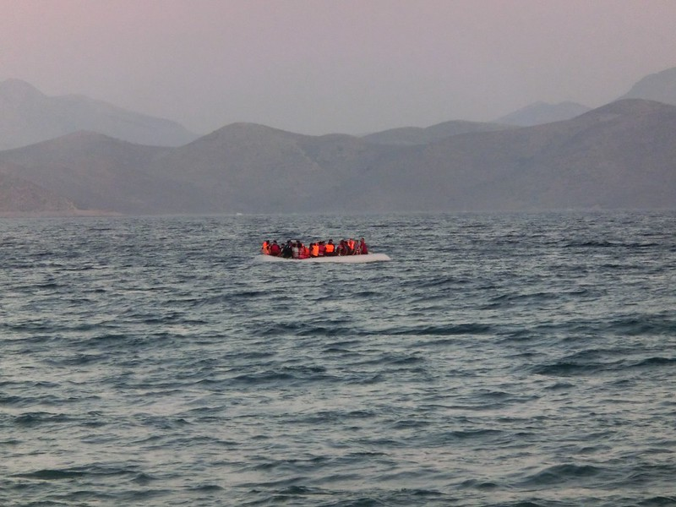
Photo: Christopher Jahn/IFRC, Sourced from Flickr under Creative Commons License

Slide 11
Please pray for people making perilous journeys

Slide 12
We pray for refugees and their host countries

Slide 13
80%
of refugees are hosted in countries
neighbouring their country of origin
85%
In countries classed as
‘developing countries’
Data: UNHCR: Global Trends in Forced Displacement, 2019

Slide 14
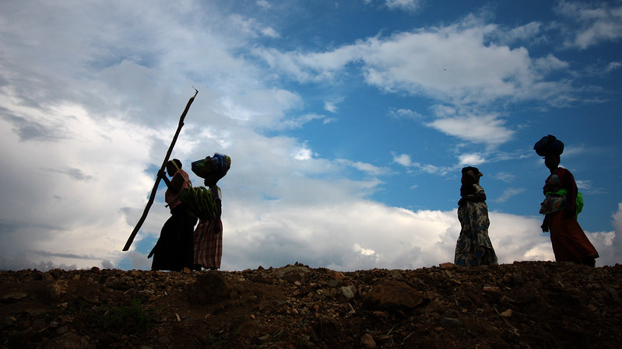
Photo: EU/ECHO/Martin Karimi, Sourced from Flickr under Creative Commons License

Slide 15
We pray for those countries that are hosting the largest numbers of internationally displaced people:
Turkey … 3.9 million people
Colombia … 1.8 million people
Germany … 1.5 million people
Pakistan … 1.4 million people
Uganda … 1.4 million people
United States … 1.1 million people
Sudan … 1.1 million people
Iran … 1. 0 million people
Lebanon … .9 million people
Peru … .9 million people
Data: UNHCR: Global Trends in Forced Displacement, 2019

Slide 16
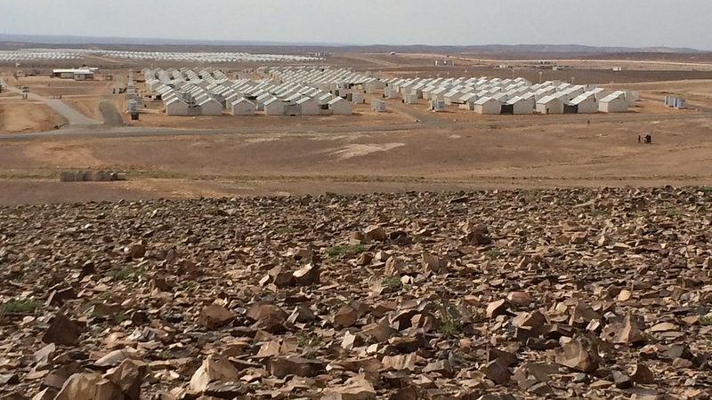
Photo: EU/ECHO/Caroline Gluck, Sourced from Flickr under Creative Commons License

Slide 17
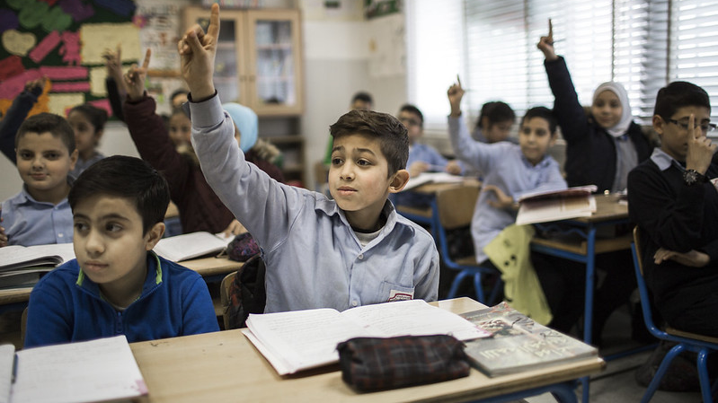
Photo: Adam Patterson/Panos/DFID, Sourced from Flickr under Creative Commons License

Slide 18
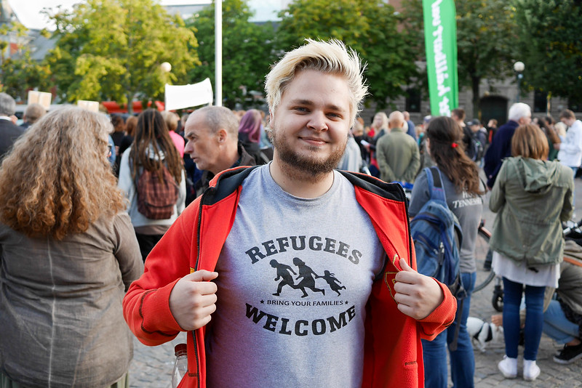
Refugees welcome Karlstad, Anton Levein. Christoffer Sonesson, Sourced from Flickr under Creative Commons License

Slide 19
Closing Prayer
Lord God, you have at times called your people to journey to new lands
And you have often reminded them to welcome and give justice to the stranger.
We thank you for gathering us in this time and this place.
And we pray that you will help us to see how we can be people of welcome, love and justice.
Help us, we pray, to offer hospitality that reflects your generous love
And an openness to others that sees your image and likeness in every person.
Show us where we can play our part in shaping a fairer society
Where people fleeing danger find sanctuary,
And everyone is given opportunities to flourish.
We ask this in the name of Jesus our Lord,
Whose parents fled their homeland to protect him from harm
And who commands us to love our neighbours as ourselves
Prayer from CCOW

Slide 20
The grace of our Lord Jesus Christ,
the love of God,
and the fellowship of the Holy Spirit,
be with us all, evermore.
Amen

Slide 21
This time of prayer has been prepared by Christian Concern for One World. We aim to help Christians and their churches
live out their calling to love God and neighbour
in a globalised world.
As part of that, we work with people, groups and churches who want to stand alongside refugees, in the Thames Valley and beyond.
To find our more or get in touch, visit our website www.ccow.org.uk

