Slide 1


Slide 2

Notes:
From the papal Encyclical Laudato Si’: http://cafod.org.uk/content/download/25373/182331/file/papa-francesco_20150524_enciclica-laudato-si_en.pdf

Slide 3

Notes:
From the papal Encyclical Laudato Si’: http://cafod.org.uk/content/download/25373/182331/file/papa-francesco_20150524_enciclica-laudato-si_en.pdf

Slide 4

Notes:
From the papal Encyclical Laudato Si’: http://cafod.org.uk/content/download/25373/182331/file/papa-francesco_20150524_enciclica-laudato-si_en.pdf

Slide 5
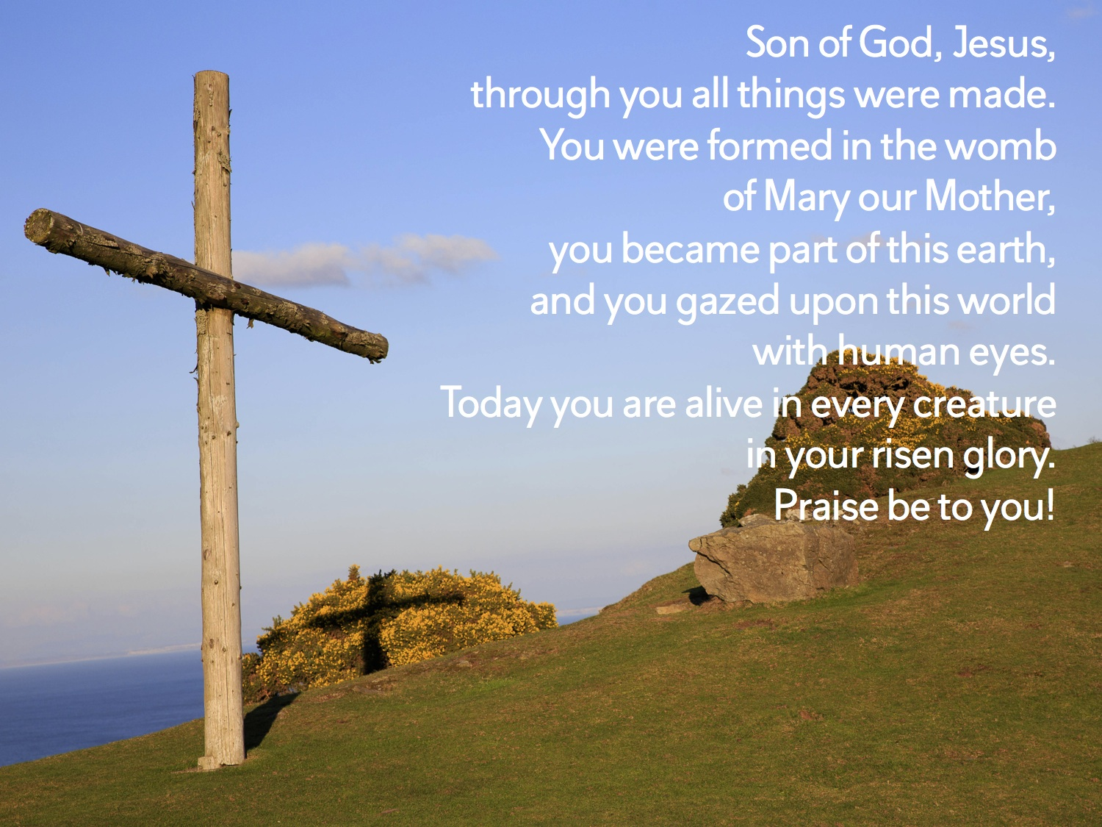

Slide 6
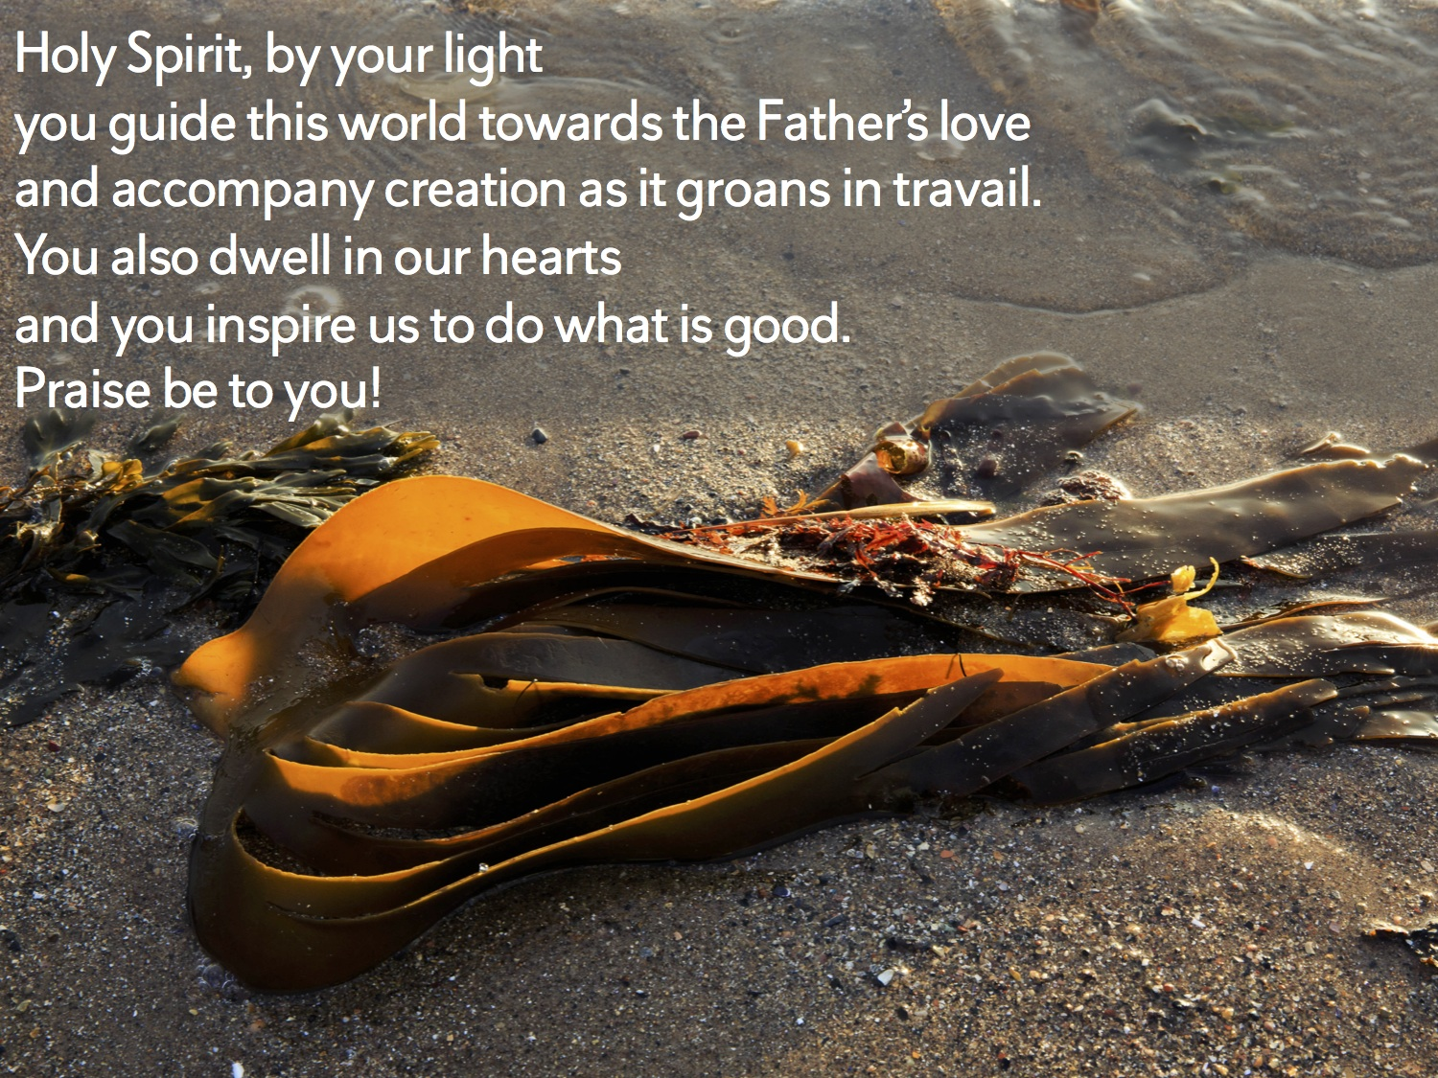

Slide 7


Slide 8
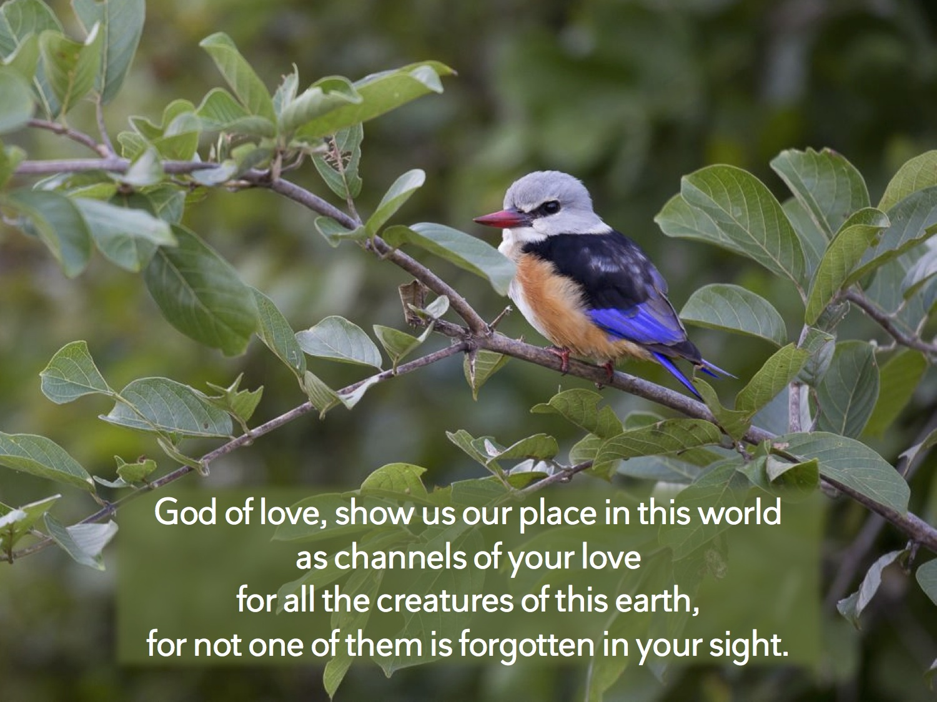

Slide 9
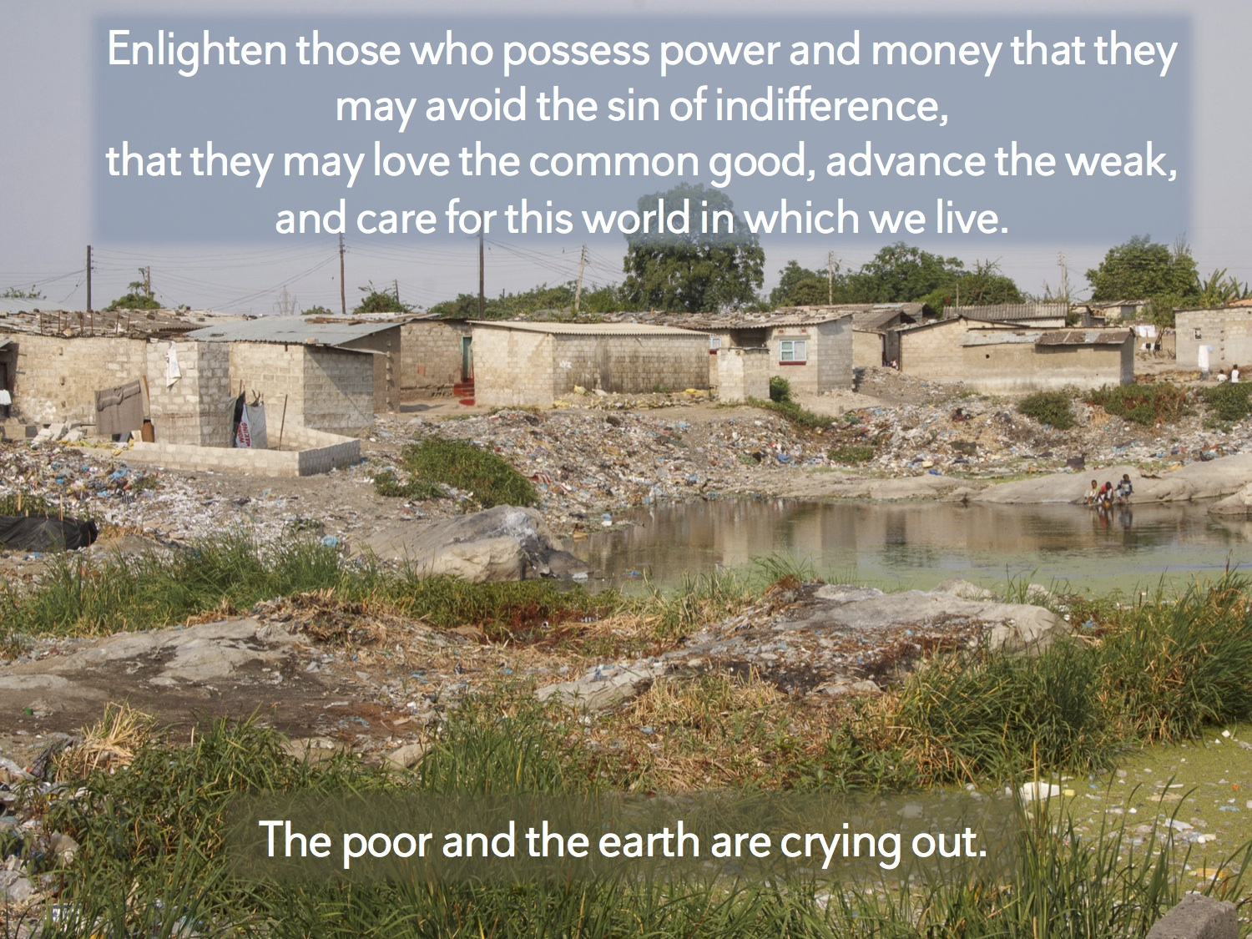

Slide 10

Notes:
The fifth mark of mission: http://www.anglicancommunion.org/identity/marks-of-mission.aspx
These prayers are written by Ann Richards, Mission Theology Advisory Group and can be found here: https://www.churchofengland.org/media/2555436/creationtide_and_environment_resources.pdf

Slide 11
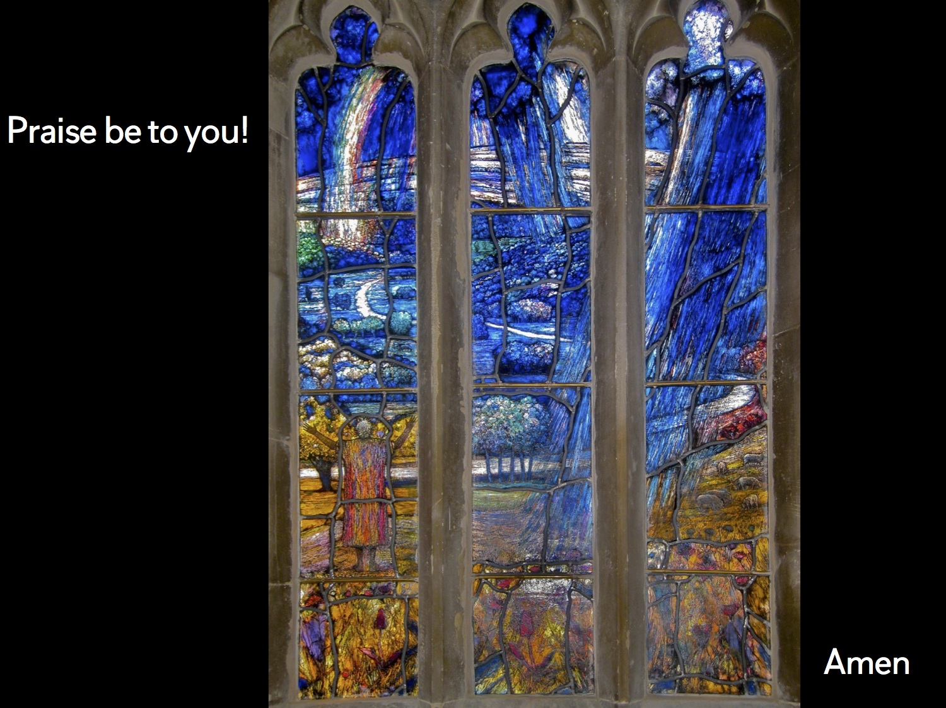
Notes:
Stained glass window by Thomas Denny.
Based on Psalm 65.
The window is in All Saints Church, Middle Woodford, Salisbury, Wiltshire, UK.

Slide 12


